Slide 1
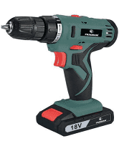
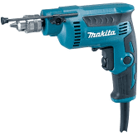
Basic power tools and machines.
1. Cordless hand drill
- It is used for loosening and tightening of screws.
2. Electric hand drill
- It is used to drills holes.

Slide 2
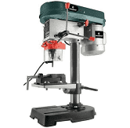
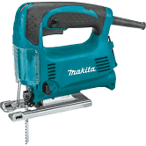
Basic marking cutting and hand tools. (continues)
3. Drill Press
- It is used for drilling of holes.
4. Jig Saw
- It is used for cutting of wood.

Slide 3
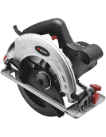
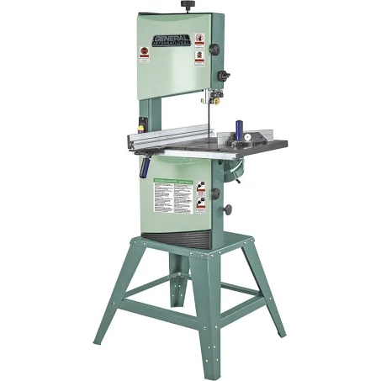
Basic marking cutting hand tools. (cont..)
5. Circular saw
- It is used for cutting of wood.
6. Bending Saw
- It is used for cutting wood.

Slide 4
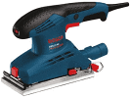
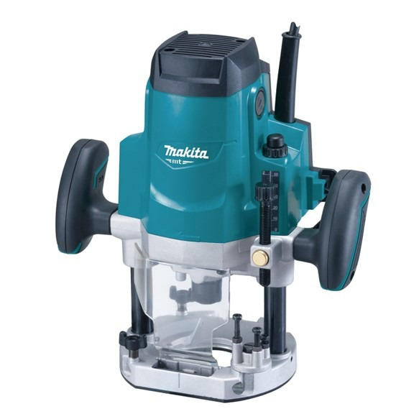
7. Sanding machine
- It is used to smooth surfaces.
8. Router
- It is used to bevel edges
Video:
https://youtu.be/rSZeu8guVIY?si=_0f76doMFRrqo334
Feedback : Activity

Slide 5
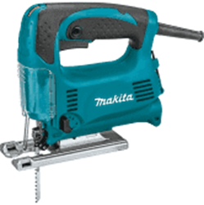
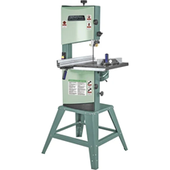
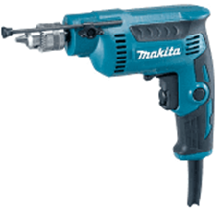
Kwa Thema Skills School
Subject : Maintenance Marks : 8
Grade : Year 1 Time : 30 mins
Date : / / 2024
Question:1
Name the following marking and cutting hand tools.
1.__________________ 2.______________________
3.___________________ 4. ______________________

Slide 6
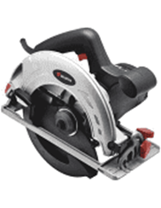
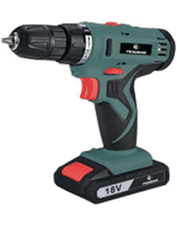
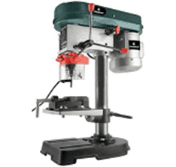
5. _________________ 6. ____________________
7. __________________ 8. ____________________
(8)

Slide 7
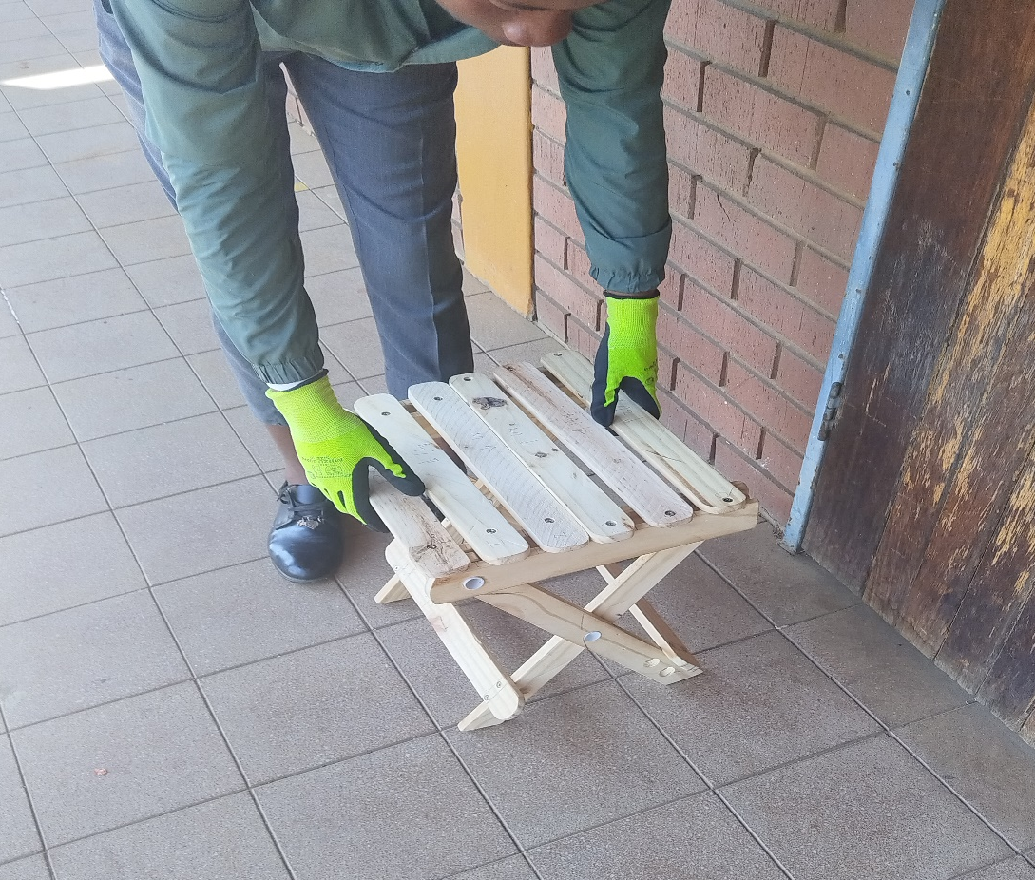
Feedback :Activity
(Practical lesson or Project)
Folding Chair

